Slide 1

WORKING TOGETHER to bring about change……………..
ADHD AWARENESS TRAINING
Alan Roberts
ADHD Training Consultant

Slide 2
This work is subject to Copyright Laws……….
The information contained in these handouts, or in electronic format,
can only be used for personal and educational purposes within the
appropriate setting.
You may not sell, alter, further reproduce or distribute any part of this
material.
The information cannot be used for training purposes without prior
consent from the owner.
2018: ALAN P ROBERTS.
ADHD Training Consultant.

Slide 3
Attention Deficit Hyperactivity Disorder (ADHD)
ADHD is a recognised medical condition of brain dysfunction. It is the neurotransmitters, which are the chemicals that carry the messages between our brain cells during our mental tasks which often break down and become mixed up.
In most cases it is not the end result of poor parenting or a “naughty child”.It is a disorder that can have serious effects if not treated.
The condition often runs in families. It affects more boys than girls in the hyperactivity-impulsive type of ADHD. In the inattentive type (ADD) it is around the same for boys and girls.
ADHD is not a new condition. Dr Still in 1902 described children in his practice with impaired concentration and overactive

Slide 4
Core features of ADHD/ADD
INATTENTION:
Often fails to give close attention to details.
Difficulty sustaining attention to tasks.
Appears not to listen to what is being said.
Often fails to follow through instructions.
Difficulty completing tasks.
Poor organisational skills.
Difficult concentrating on activities.
Short-term memory problems.
Often lose things for certain tasks.
Easily distracted.
Often forgetful.
Can make careless mistakes.

Slide 5

HYPERACTIVITY:
Often fidgets or squirms in seat.
Constantly restless and on the go.
Appears driven by a motor.
Can be very noisy when playing.
Often talks excessively.
Interrupts conversations.
Calls out and speaks without thinking.

Slide 6
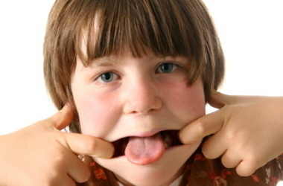
IMPULSIVITY:
Often blurts out answers to questions.
Finds it difficult waiting turn.
Interrupts and intrudes on others.
Can get into difficult situations.
Does not think of consequences.

Slide 7

Impact of ADHD on the Family
ADHD affects everyone in the family whether they have the condition or not. Over half the families describe situations as tense, full of conflict, and constantly “walking on eggshells.”

Slide 8
Impact On Parents
How parents react to their own child or teenager depends on whether they have ADHD themselves
Guilty often with themselves that they gave it to their child
Edgy due to their child’s behaviour
Blamed for “bad parenting”, it may not be their fault but often other people see the results of ADHD as bad parenting
Angry with other people who don’t understand what they are going through and being let down by “the system.”
Isolated due to other family members and friends not wanting visit, or don’t want to invite them to their home for fear of the child’s negative behaviour
Difficult Relationships as conflict may lead to parents break-up
Depression with some parents often feeling a failure, constantly run-down with the physical and emotional pressure that comes with having a child with ADHD.

Slide 9
Impact On Siblings
These are things often said by the sibling of children about their bother or sister who has ADHD.
“She/he always gets away with things I don’t”
“Its one rule for me and another for him/her”
“I’m never treated with any respect”
“ I never get any privacy”
“We never go out anywhere because he/she won’t behave”
“He/she always embarrasses me by his/her stupid behaviour”
“My friends stop coming ‘round because he/she wont leave them alone”
“I’m always on edge about what he/she may do next”
“He/she always takes things from my room and they always go missing or come back broken”
“You always take his/her side”

Slide 10
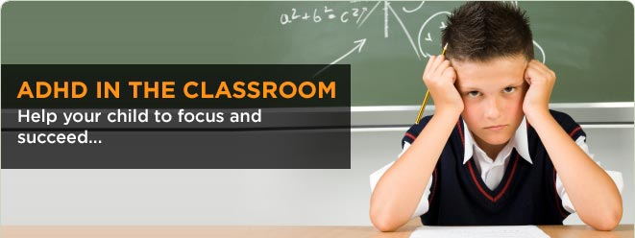
SCHOOL PROBLEMS:
90% under achieve at school.
At least 60% have reading difficulties.
80% have serious handwriting difficulties.
35% drop out of high school before finishing
55% have been suspended at least once.
Up to 20% have repeated a year at school.

Slide 11
SCHOOL PROBLEMS contd:
Impulsive outbursts lead to confrontation with teachers.
Difficulty remaining on task can lead to specific learning difficulties.
Poor social skills and difficulty forming peer relationships, which often leads to isolation.
Normally suffer from low self-esteem and confidence.
No concept of time, intrudes on others space.
More likely to develop speech and language problems.
Often suffer from poor co-ordination skills.
SOURCE: ADDIS survey 2004.

Slide 12

CHILDREN’S QUOTES.
Information taken from a survey by ADDISS in 2004.
“ If teachers know you are ADHD as soon as someone does something they will blame you instantly”.
“ I’m always forgetting things, my PE kit, pencil bag, letters I need to give to parents, and more. I don’t mean to, I just can’t help it”.
“ I often daydream at school due to my ADHD, by the time I realise everyone else is two pages ahead”.

Slide 13
PARENTS CONCERNS ABOUT SCHOOL
Information from the ADDiSS survey 2004.
70% of parents surveyed described the impact of ADHD on their child’s education as “huge”.
90% worry about the impact ADHD has on their child’s future.
A quarter of parents felt they rarely get to see their child as they really are as medication often wears off by the time they arrive home from school.
83% of parents felt it was important for their child to have control of their ADHD symptoms during the day.
Around 48% of parents thought their child also needed to have control at home in the evening.

Slide 14
OTHER MENTAL HEALTH DIFFICULTIES:
Around 80% or more have Oppositional Defiant Disorder.
Up to 45% display conduct disorder.
25% display anti-social behaviour.
Up to 40% may display clinical depression or anxiety disorders.
50% may have emotional difficulties.
80% or more suffer with poor communication problems.
Most have a lack of fear, take risks and have no understanding of consequences.
Some have a high pain threshold and may not recognise when they have an injury.

Slide 15
Other MENTAL HEALTH DIFFICULTIES contd……….
Up to 40% of children with ASD have a dual diagnosis of ADHD. (Dr Tony Lloyd 2115).
18% will attempt suicide. (Lathey 2010).
40% of children with ADHD also have dyslexia.
30-40% have additional learning difficulties.
( Wender 2002 ).
NICE guidelines of 2009 states:
“All children have the right to a school experience that
provides a broad balanced and relevant curriculum which
is appropriately differentiated according to their needs”.

Slide 16
Did you know……..
Boys are diagnosed 3 times more often than girls with ADHD. With ADD it is around 50% each.
Emotional development could be up to 30% slower. A 20 year old could have the emotional maturity of a 14 year old.
75% of boys diagnosed have hyperactivity.
60% of girls diagnosed have hyperactivity.
At least 50% suffer from sleeping problem
Source: ‘Taking Charge of ADHD’.

Slide 17
CHILD’S PERSPECTIVE
OF
ADHD

Slide 18

UNPOPULAR.
Why am I different to other children?
Why do I have to take this medication?
Do I take these tablets because I’m naughty.
What is ADHD, Why have I got it?
Why do I always get things mixed up inside my head?

Slide 19

CONFUSED.
Why don’t I get invited to anybody’s party?
Why don’t I have many friends?
Why don’t many people seem to like me?
People think I’m always silly and believe others when I’m
blamed for things I don’t do.

Slide 20

STUPID.
I must be more stupid, he does more work than me.
I never get my work put on the wall.
Everybody else seems to get praised more than me.
Why do I keep making so silly mistakes?

Slide 21

FRUSTRATED.
I often do things different to others but not so good.
I often forget or lose lots of things.
Sometimes I don’t understand what other people are asking
me to do.
I find it difficult completing pieces of work.
I wish I didn’t make so many mistakes.
I don’t seem to get anything right.

Slide 22

ANXIOUS/STRESSED OUT.
I want to please other people but find it difficult.
I find it really hard coping with my ADHD at times.
I wish I didn’t behave so badly.
I only wish I could please more people so they liked me.

Slide 23


SCARED.
I don’t know how I’m going to be in future.
Sometimes nobody will love me because I behave so
badly.
I feel very frightened about having ADHD.
I wish I could stop doing so many silly things.

Slide 24

ANGRY.
Often with myself because I’m impulsive and feel sad
about what I’ve done after.
Other people that don’t understand me.
With pupils who bully me and call me names because
they think I’m stupid.
When I’m blamed for things I don’t sometimes do.
Because I have ADHD and don’t want it.

Slide 25
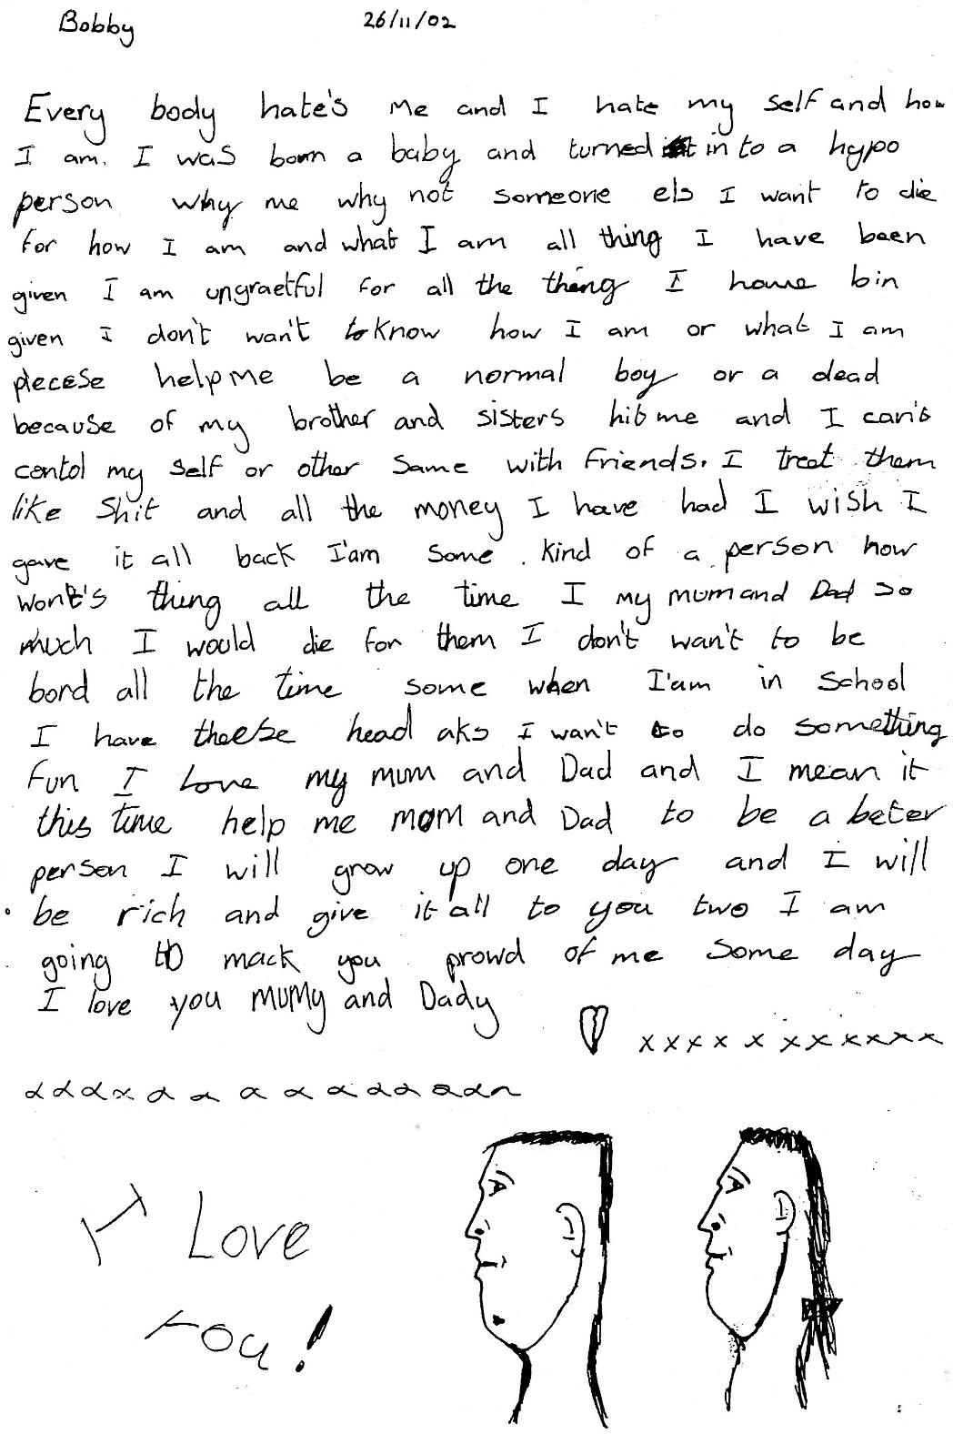

Slide 26
What problems does your ADHD cause you in school?
I talk too much without realising it.
I can’t concentrate for long or organise myself.
I often start to talk louder without knowing I do it.
Too many pupils in the class and too loud.
Teacher’s can't control the class.
I fiddle too much an daydream.
I try and correct people if I think they are wrong.
I shout out answers without thinking.
Struggle to work in groups, it’s too loud and get confused.
My hand writing is not very good.
I can’t write things down quick enough.
I have short-term memory problems.
SOURCE: ADHD Pupils from Flint High School.

Slide 27
How does having ADHD make you feel?
Frustrated, I often become confused.
Annoyed when other people wind me up.
I imagine other pupils and teachers talk about me having ADHD.
Anxious, I can think too many things at once.
Angry when I get blamed for things I don’t do.
ADHD is like having a computer game that never ends.
I often feel like I’m not wanted or liked by anyone.
Feel like giving up when I can’t get anything right.
It’s like a boat across an ocean that only stops when it sinks.
Scared when my behaviour can be really bad at times.
Teachers want to always find a reason to get me out of the class.
I feel treated differently by teachers like I’m stupid.
SOURCE: ADHD Pupils at Flint High School.

Slide 28
How do you think your ADHD makes teachers feel?
Frustrated, they don’t know or understand how to control us.
Angry when I can’t stop fiddling with something.
They wish I wasn’t in school today or in or her class.
Tired as my ADHD behaviour can often wear them down.
Some teachers wish they could help me more.
They may feel this school is not the right one for me.
Blame my mum or dad for the way that I am.
SOURCE: ADHD Pupils from Flint High School.

Slide 29
What could teachers do more to help you in the classroom?
Listen more when I’m trying to explain something.
Slow down the lessons.
Give me less information at a time.
Explain information in a different way to make sure I understand it.
Believe me more, I get muddled-up at times when I say things.
Let me know more when I get things right.
Give me more time to stop to work things out in my head.
Give me a ‘time-out’ card to use when I become frustrated.
Need breaks to walk around, I can’t sit for long.
More ‘hands-on’ lessons as I struggle to write.
Not to be sent out of the class all the time.
Give me time to calm down by myself.
SOURCE: ADHD Pupils from Flint High school.

Slide 30

What advice could you give new ADHD Pupils coming into this school?
Always ask teachers for help.
Make a list for your Head of Year of how your ADHD affects you and what help you will need.
Don’t over think.
Always take your medication.
Don’t take your anger and frustration out on others.
Talk to other pupils who have ADHD and share ideas.
Make sure you organise yourself more.
Make posters to help you remember things.
SOURCE: ADHD Pupils at Flint High School.

Slide 31
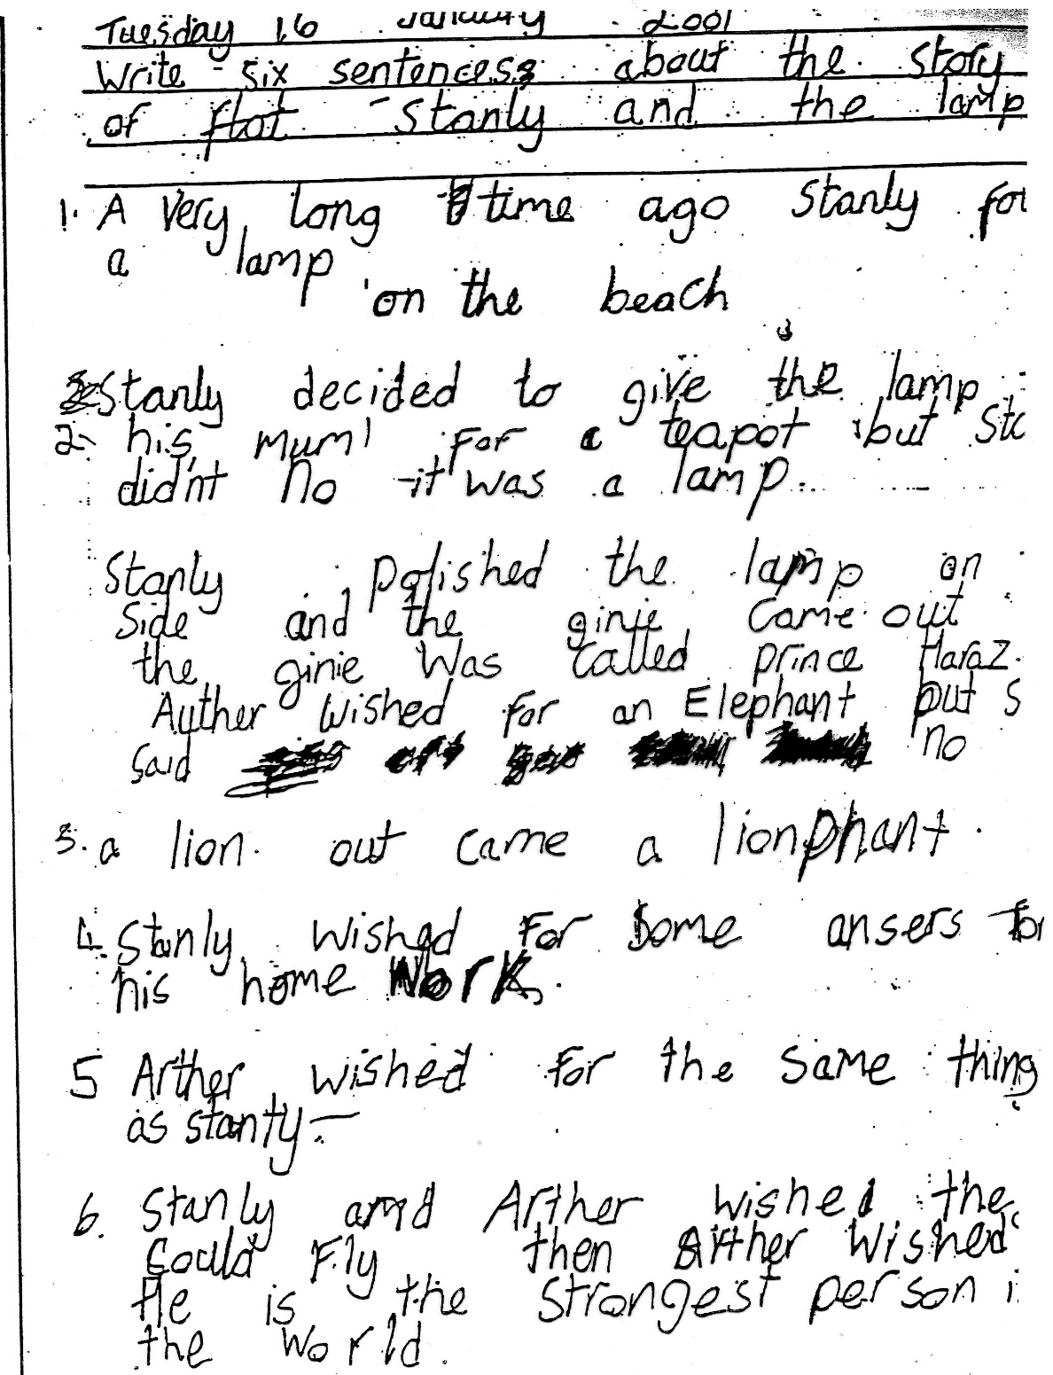

Slide 32
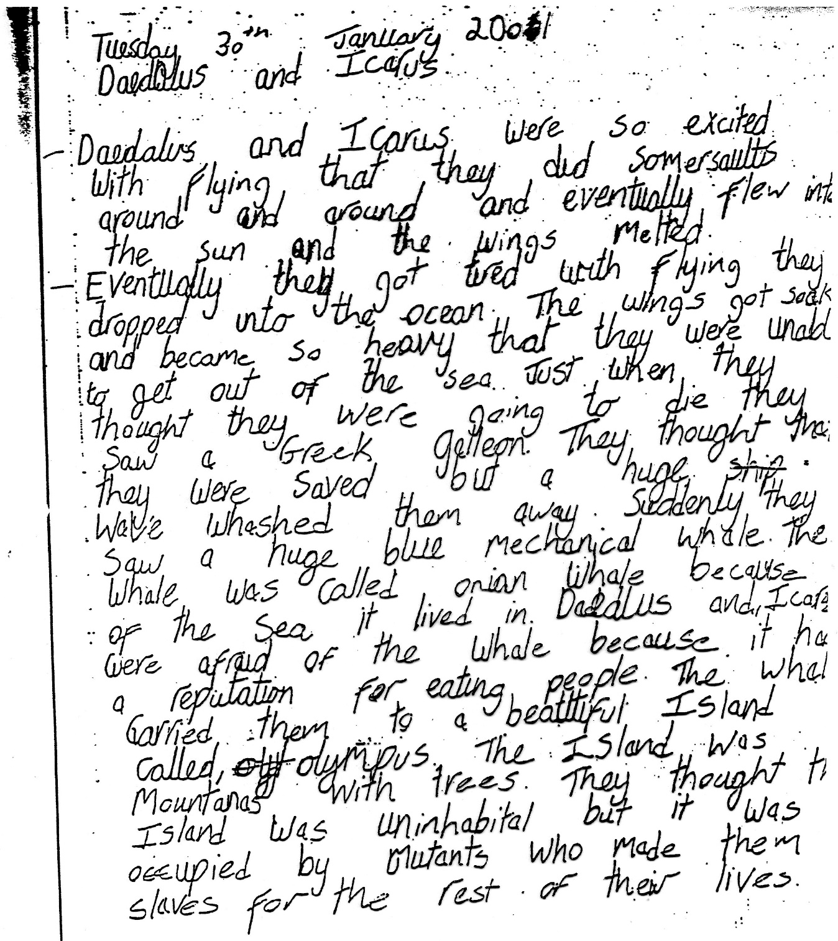

Slide 33

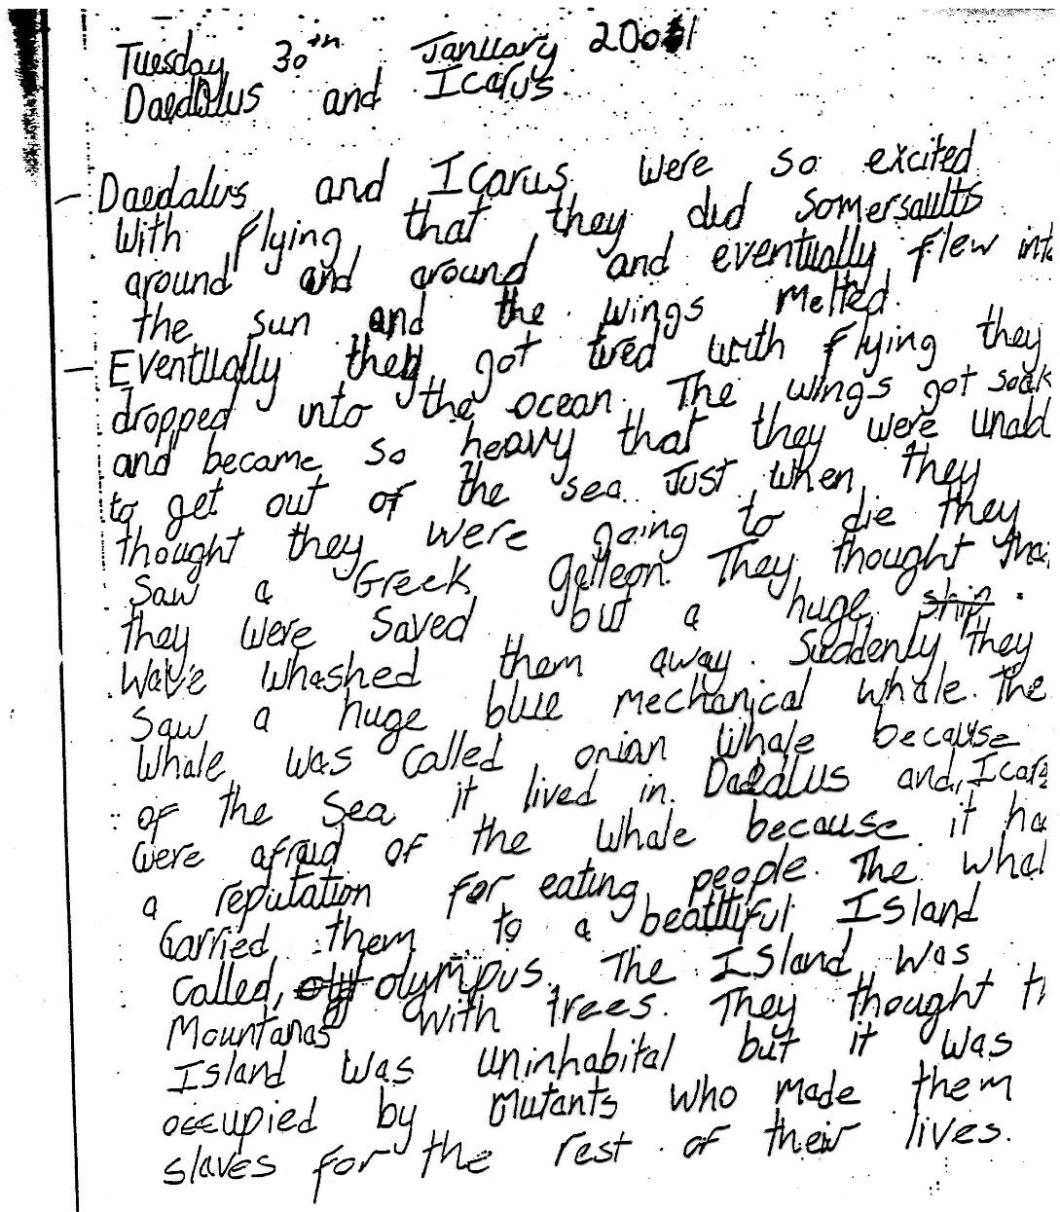

Slide 34
LINKS BETWEEN YOUTH OFFENDING AND ADHD.
ADHD adults are four times more likely to have road traffic accidents.
Up to 68% of the prison population in the UK have ADHD.
ADHD youths are 4 to 5 times more likely to be arrested and have multiple convictions.
Around 40% of reoffending ADHD adults are housed in medium security prisons.
Severe ADHD can co-exist with Bipolar Disorder or Manic Depression causing unstable mood swings and aggressive rages.
September 2003 – 200,000 are dealt annually by the Youth Justice System. Figures suggest that up to 50% of these were expected as having ADHD. SOURCE: The Tipping Point. (Book)

Slide 35
CONNECTIONS BETWEEN FIRE STARTING AND ADHD
IMPULSIVE: Often unable to think of consequences of their reactions.
RISK TAKING: Without realising dangers to themselves, others, or property.
POOR SOCIAL SKILLS: Can be easily influenced by peers.
HYPERACTIVITY: Don’t have the time to stop and think of the outcome.
HIGH INTELLIGENCE: Have a “Need to Know” how thinks work or burn.
SHORT-TERM MEMORY: Easily distracted or often forget what they are doing. ie: making toast, cooking, leaving electrical appliances on.

Slide 36
ADHD and RISKS.
Easily influenced by peers or adults.
More likely to become involved in alcohol or substance misuse.
Oppositional Behaviour leads to arguments and violent outbursts.
Have no road sense.
No fear of dangers may lead to a higher risk to injury.
More likely to go missing due to having no concept of time.
Lack of sexual or body awareness.
More likely to be bullied at school or in the community.
Lack of understanding consequences.
More vulnerable and at risk towards predators.
Higher risk of suicide or possible self harm.
Links between fire starting and ADHD.
Most have a “High Pain Threshold” and don’t feel pain.
Inability to read social cues.
Short – term memory. Can’t remember what they did or with who.

Slide 37
HYPERACUSIS.
‘Hyperacusis’ is an extreme aversion and hypersensitivity towards sounds that are generally not an issue to others.
Reactions can be very minor to some when they hear a certain noise. For others it can have a major impact on life. Low level noises can feel uncomfortable, loud and painful which can often trigger anxiety.
Some react by covering their ears or leave the room or situation. They may be crying, angry, and in panic.
As a result some people may avoid noisy situations and become socially isolated. People with severe Hyperacusis may feel suicidal.
It is estimated between 12% to 27% of children can be affected.
SOURCE: NHS CHOICE web site.

Slide 38

HYPERACUSIS contd…………..
Children may struggle to cope in school where background noise can make it difficult for them to concentrate.
Noises that are commonly an issue with children include:
Various classroom noise, school bells, school hall – including lunch times, PE lessons, assemblies, break-times, trips out.
Dogs and barking.
Laughter, shouting, and large crowds.
Screaming, whistles, thunder.
Various forms of transport noises, fireworks, balloons.
Electrical items such as vacuum cleaners, drills, telephones, and others.
Hyperacusis is extremely difficult to diagnose because it is a subjective experience that is hard to measure.

Slide 39
OCULAR MOTOR APRAXIA
Ocular Motor Apraxia is a rare neurological condition affecting control of eye movement. People with this condition have difficulty moving their eyes horizontally. And may develop side-to-side head thrusts to compensate. You may also notice a delay in their eye movements.
They may:
Have to turn their head in order to follow objects at a gaze.
Be slow when performing tasks that involve scanning or switching their attention between locations. Struggle when trying to read.
Often seem clumsy, bump into things, blink more than most people do.
Avoid eye contact, role their eyes while speaking to you.
Not be able to watch fast moving TV programmes.
Have developmental delays, speech difficulties. Also some behavioural issues such as Autism, ADHD, Sensory Processing Problems.
May dislike travelling in a car or other sorts of transport.
SOURCE: omapraxia.com

Slide 40
LONG TERM OUTLOOK of HAVING ADHD.
Many young adults will not simply “outgrow” their symptoms. However, in most cases the severity might decline.
Between 70 – 80% may continue to show problems with attention and impulsivity.
As many as 50% will continue to exhibit significant behaviour problems, defiance, and display anti-social behaviour.
They could have completed up to two years less formal schooling than their peers.
Only 5% may complete a university degree compared up to 40% of their peers.

Slide 41

LONG TERM OUTLOOK contd……………………………..
BRAIN GROWTH between 11-13 years of age.
Frontal lobes of the brain grows between the age of 11 to 13 which may be the reason why some ADHD students have fewer symptoms. The problems won’t go away but may become less severe.
BRAIN GROWTH between 19 - 20 years of age.
The brain normally grows again and ADHD may become less of a problem. However, the student still may show signs of immaturity, impulsivity, have difficulties focusing on routine, and still struggle with time management and organisational skills.

Slide 42
LONG TERM OUTLOOK contd…………...
People with ADHD are more likely to be dismissed from employment and often try lots of jobs before finding one they can succeed in.
May choose specific types of work and are frequently self-employed.
They experience more interpersonal difficulties due to poor communication problems.
Many people with ADHD have no concept of time and may turn up late for work, appointments, or are often absent.
They may make excessive errors, careless mistakes, or an inability to complete expected work loads.
Some stop taking their medication and become a higher risk of substance abuse.
Remain disorganised, forget to take things to work or lose things for tasks.
Have no fear of dangers or road sense. May lead to injuries at work.
Suffer from poor money management.

Slide 43
POSITIVE CHARACTERISTICS of ADHD………
Energetic.
Very creative.
Ability to find alternative paths to overcome obstacles.
Willing to take risks.
Unlimited energy.
Able to think outside the box.
Good long-term memory.
Hard worker.
Good at solving problems.
Flexible.
Original .
Quick learner.
Need to know how things work.
Can be very loving and caring.

Slide 44

For young people to succeed in adult life parents and professionals clearly need to work more closely together to bring about positive changes
Remembering that………………..
THEY ALL DESERVE A
CHANCE IN LIFE

Slide 45
What was Secondary School like when you first started?
I was worried and anxious.
Couldn’t cope with all the different changes.
Difficult getting used to new rules and teachers names.
I often forgot to bring things in I needed.
The day was too long.
I got lost in school due to changing lessons.
Shock of the large amount of homework I was expected to do.
Not knowing who else had ADHD.
Thought I was on my own and felt isolated.
Not knowing anyone or what friends might be here.
Possibly being bullied.
SOURCE: ADHD Pupils from Flint High School.

Slide 46
How does your ADHD cause you problems at Darland School ?
I get muddled-up with certain letters and spell words wrong.
I sometimes get called names and bullied because I have ADHD.
I have a short-term memory and can’t remember what teachers tell me. They say I should listen more.
Teachers give me too much information and I get confused.
By the time I get home I can’t remember what homework I have been asked to do.
I get easily distracted in some lessons.
I sometimes say things I don’t mean and get into trouble.
I make mistakes without knowing.
I struggle to make friends. Nobody wants to know me.
I’m always losing things I need to take into school or bring home.
I forget how much I’ve been asked to do.
SOURCE: Year 7 Pupils.

Slide 47
ADHD is hard work…………..
Students with ADHD can place many demands on your time and energy. The constant interruptions, need for repeated instructions and close supervision can be taxing.
Remember……….. Most students with ADHD are:
Not trying to be disruptive.
Often regret their behaviour but are unable to stop at times.
Often unaware of their disruptive behaviours.
Not mounting a personal attack on you.
Students with ADHD often do best with teachers who are:
Flexible, recognise and support individuality.
Understand their needs and capability.
Present information and tasks in steps.
Provide a range of different activities.
Set firm limits and have a structured learning environment.
Believe in what they can achieve.

Slide 48

ADHD or SLEEP DISTURBANCE?
“Sleep deprivation can cause daytime hyperactivity and decrease in focused attention. This can sometimes be mistaken for ADHD or other disorders”,
National Institutes of Health.
Inadequate sleep can causes problems with:
Performance.
Concentration.
Reaction Times.
Unable to retain information.
Difficulty staying on task.
Behaviour Problems.
Making Mistakes.
Accidents and Injuries.
Mood swings and aggressive outbursts.
Difficulty thinking through situations.

Slide 49


THE INFLUENCE OF OUR THOUGHTS
The way in which we think about or interpret
situations can determine our feelings and actions.
Negative or hostile thoughts about a person or
situations can often result in angry feelings and
actions.
These negative or hostile thoughts can be unhelpful
and often cause the child, or the teacher stress.
Replacing the negative thoughts with less negative ones can help…
49

Slide 50

POSSIBLE NEGATIVE THOUGHTS ABOUT A SITUATION:
I’ve told him three times what to do – HE never seems to listen.
She always forgets to bring things to school on purpose.
He never does things I tell him to.
He never waits his turn.
He/She never turns up for detentions.
He’s always trying to annoy me.
He never does his homework
I don’t know how many times I have to remind him about his PE kit.
Why does he always try to have the last word?

Slide 51
SUCH NEGATIVE THOUGHTS AND INTERPRETATIONS TEND TO RESULT IN:
ANGER
FRUSTRATION
STRESS
ANXIOUS
THESE FEELINGS CAN RESULT IN ACTIONS SUCH AS:
SHOUTING.
GIVING DETENTIONS.
ARGUING.
PUTTING THE PUPIL ON REPORT.
MEETING WITH PARENTS OR A LETTER HOME.
PUPIL BEING SUSPENDED OR EXCLUDED.

Slide 52
USING ALTERNATIVE THOUGHTS CAN BE HELPFUL:
He may not be doing this deliberately.
He has a short-term memory span.
He can only concentrate for small periods.
She has more difficulties controlling situations than other pupils.
His organisational skills may be poor.
ADHD makes it harder for him to manage himself.
If I can continue to argue with her I’ll get more frustrated.
He’s probably frustrated with himself too.
He may not of understood what I want him to do.

Slide 53
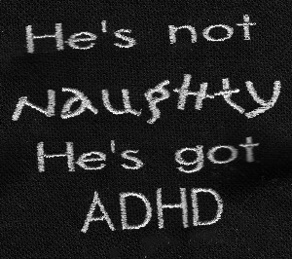

Slide 54
COMMUNICATION SKILLS.
Some children/young people have a short-term
memory span. They may only take in 40 to 50% of
the information you give them. Try and keep all
requests short and to the point. The longer the
message the more confused they might become.
Ask them to repeat back the message.
However, long-term memory can be extremely good.
Active children/young people often focus more
when they are doing two things at once. Giving
he/she a soft ball, blue tac, plastercine, etc to
fiddle with may help them stay on task.
Visual indicators are normally helpful when trying
to communicate or get the message across. This
can be achieved using a mini whiteboard, pictures as a prompt, or introduce a visual timetable.
54

Slide 55




Slide 56
Set realistic, short-term targets.
Don’t assume because of the pupil’s age he or she should be able to manage the task. Try to remember socially and educationally they could be at least 2 to 3 years behind.
Use clear straight forward language and keep rules simple.
Only give one instruction at a time. Ask the pupil to repeat back the instruction.
56

Slide 57
Where possible, make lessons more challenging, or when concentration is needed, earlier in the day when ADHD medication is at it’s peak.
Use of a computer helps maintain interest and attention for longer and adds motivation.
Try and provide a variety of learning activities during each lesson.
Visual define the space in which written answers are to be recorded.

Slide 58

SEATING………
Create a quiet area free form distractions for test taking or quiet study.
Seat away from windows and doors when possible.
Always try and seat pupil at the front and side of the class so he or she can see everything that is going on around them.

Slide 59
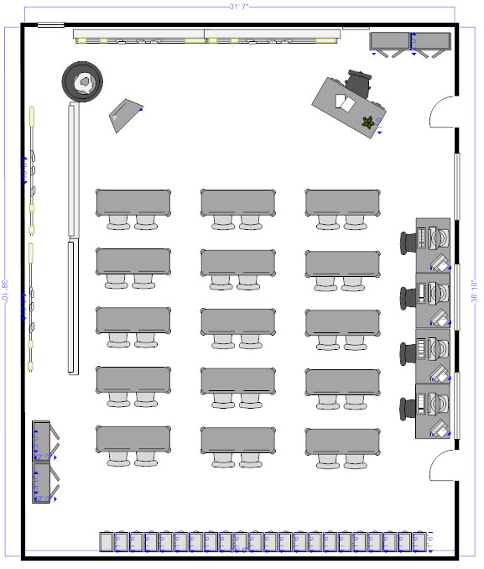

Slide 60
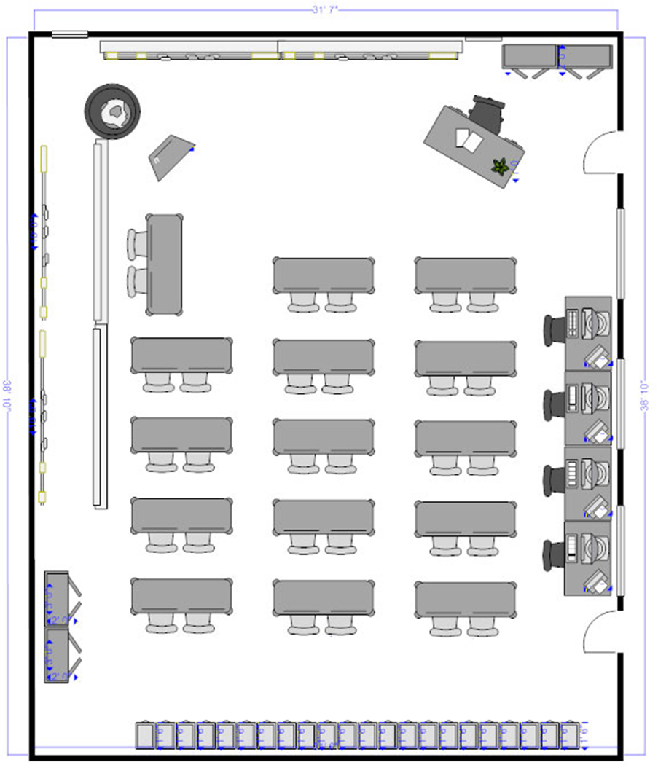

Slide 61
Some children/young people often get ‘muddled-up’ when trying to tell you something. You may have to stop them at times to bring them back on track. Sometimes it may feel like they are lying
when they can’t tell the story correctly.
As some children/young people have no concept of time they may need extra support in reminding them that they need to be somewhere, or they have limited time to complete a task.
61

Slide 62
COMMUNICATING EFFECTIVELY
Always try and choose a time when the pupil is more co-operative.
Don’t try and communicate when the pupil is angry, this will only make matters worse. Try and keep calm and find somewhere quiet they can go.
62

Slide 63
Try to gain eye contact when you can, this is not always easy. With younger children ask them to put their hands on top of yours, tell them the talking vibrations can help you hear them more clearly. It can help them focus more.
Your speech needs to be clear and heard. Keep all messages simple and direct. Use as fewer words as possible to get your message across.
Use Active Listening by showing the pupil you are willing to listen to them. When you need to, repeat back to them what they are trying to say and how they might feel.
63

Slide 64
Give them a structure for conversations:
Make two signs together with your child.
Draw an EAR on a card – this will identify the listener.
(Can’t speak when holding the EAR card)
Draw a MOUTH on the other card – this will identify the speaker.
This can make communication more fun whilst also helping to teach the child rules of communicating.
64

Slide 65

EAR
65

Slide 66
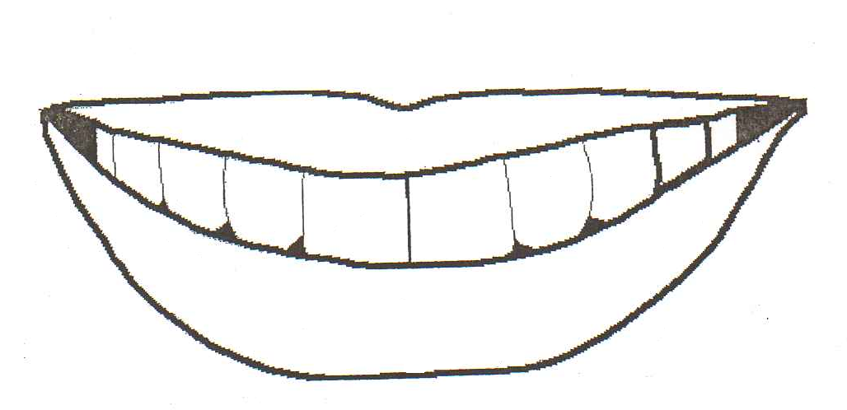
MOUTH
66

Slide 67

“I need some help please”
“I NEED HELP”
“I’M OKAY FOR NOW”
If the child does not want to use the coloured card a small ruler could be used with a green dot on one side and a red dot on the other.

Slide 68


VERBAL INTERUPTIONS
ADHD children often interrupt classroom conversations or shout out and won’t wait their turn. To help combat this make 3 ‘Question’ life cards. Give the child 3 cards which he/she can use to ask a question in a given time. Eg: Between now and break-times.
The child gives a card to the teacher every time they ask a question. Hopefully, this may stop the child taking up too much lesson time. The “Hand” card can help them remember to put up their hand to answer a question.

Slide 69
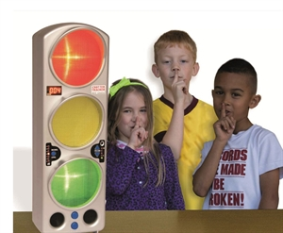
CHATTER TRACKER

Slide 70
Break down any work given into manageable
small chunks. You may have to allow for short
work periods and include breaks.
More active pupils do not like ‘change’. Keep
consistency where possible and establish
clear boundaries and structure.
Use positive praise whenever possible.
Provide visual aids to remind pupil of the task.
Give written as well as oral instructions.
70

Slide 71
Signal the start of each lesson with a visual poster or oral cue.
Have different folders for completed and uncompleted work.
Make sure you test the pupils knowledge and not the attention span, even if it appears they have not listened.
Give prior warning if any changes in daily routine will happen.
Draw a hand in the corner of the ‘white board’ to remind pupils to put up their hand to answer questions.
Teach pupils how to ‘stop and think’ before talking. This can be done by all waiting 10 seconds before accepting answers from individual pupils.

Slide 72


IMPROVE ABILITY TO LISTEN TO INSTRUCTIONS.
Firstly, consider when was the last time the pupil
had a hearing or eye test. You need to confirm
that the pupil can see and hear okay.
Could give pupil written instructions in advance
of telling rest of class but miss out key words
that pupil has to fill in whilst listening.
Consider giving the pupil something to fiddle with whilst listening, sometimes it can improve their concentration span.
Allow the pupil to have frequent breaks to get off his/her seat and walk around. Send the pupil on an errand or small job to do. After a short time get him/her to return back to the subject work.
.
72

Slide 73
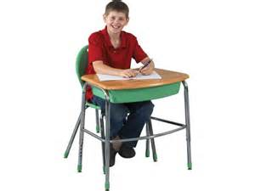
Introduce ‘life cards’. Start with given amount of cards. Every time pupil off seat for no apparent reason he/she loses a card.
Also need to introduce a strategy for gaining the cards back.
At end of session points are given for number of cards left.
73

Slide 74


IMPROVE ABILITY TO START TASKS AND SETTLE
DOWN TO WORK
Give tasks in short ‘chunks’; check work when
each ‘chunk’ is finished.
Check at regular intervals if pupil has settled. Use
tick chart to mark evidence and reward with
individual points at end of each session.
Take any distractions away from pupil. ie: pencil
case, bag, etc. Pupil is only given the items
needed to complete task.
Use visual indicators when possible.
74

Slide 75
When I’m Stuck………….
LOOKING FOR SOLUTIONS.
WHAT HAPPENED?
WHY DID IT HAPPEN?
COULD THE PROBLEM HAVE BEEN AVOIDED?
IF IT HAPPENS AGAIN – WHAT COULD I DO DIFFENRENTLY?
WHAT HAVE I LEARNT BY WHAT HAPPENED?
HOW DOES YOUR BEHAVIOUR MAKE OTHERS FEEL?

Slide 76

NAME OF PUPIL: James Carrey. YEAR GROUP: NY10
I have difficulties in the following lessons: PUPIL PROFILE.
ENGLISH: I’m given too much information at once and become confused about what I have to do. The teacher does not give me enough time to write down the homework at the end of the lesson.
MATHS: The work I have to do is not clearly explained and I often get it wrong. I can’t concentrate for long but the teacher thinks I should. I struggle to sit still and get told off.
SCIENCE: At times it is far too noisy in the classroom when we are working in groups doing experiments. I struggle to understand what I have to do. I panic then make silly mistakes.
HISTORY: I get mixed-up trying to keep up with what the teacher is talking about, my brain can’t take in all the information. I don’t get enough time to write things down he puts on the white board, when I try and copy off someone I get told off.
PE: I become anxious when I can’t follow instructions or make mistakes. I struggle to work in groups. Sometimes I get mixed up with what the teacher said because there are too many different noises going on at once.

Slide 77
What can the teacher’s do to help?
If there is a lot of work to remember write it down for me or give me a worksheet to help me understand the work.
Ask me to do one thing at a time so I don’t get mixed up.
Write any homework I have to do on the board at the start of the lesson.
Let me fiddle with something in a lesson as it helps me concentrate more.
Allow me to have a small breaks in lessons to gather my thoughts.
Let me copy off someone when I need to, I can’t write as fast as most pupils.
In noisy lessons the teacher should let me sit by him/her.

Slide 78
What can you do to help yourself?
Try and organise myself more.
Ask for help instead of sitting waiting for sir to come to me.
Have a card I can show the teacher with a list of my main problems on, I can’t expect the teacher to remember everyone.
Explain you need more time to write things down.
Go to homework clubs to get more help.
What stops you doing this?
Teachers who don’t want to listen to what I have to say.
I’m frightened to ask in case I get told off or to sit down.
Being told I can’t when I ask for help.
Embarrassing myself in front of other pupils.

Slide 79
What help can you get at school.
Always ask for help from teachers or support workers.
Discuss with your teacher about having a ‘Time-out’ card you can show when you feel angry or you can’t handle your emotions.
When you struggle to sit still ask your teacher can you get up for a while or help do a job where you need to walk around.
Agree with your teacher something you are allowed to fiddle with, this might help you concentrate more.
Try and keep organised. Keep things off your desk you don’t need.
You might get confused if you are given too many instructions at once. Tell your teacher you can only cope with one instruction at a time otherwise you get confused.
Carry a note book so you can write things down you need to remember. Ask your teacher to write reminder notes for home work or things you have to bring into school.

Slide 80
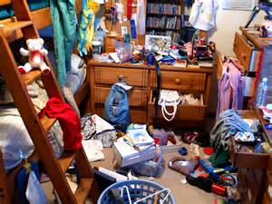
ORGANISATIONAL SKILLS
Children who are active normally have major problems with organisational skills such as:
Forgetting where they put things
Remembering to do things
Losing things
Time management
Remembering to bring homework in or deadlines
Can’t remember the order they have to do things in
May forget to come and see you when they are asked
80

Slide 81
Where have I put things?
Most young people find it difficult keeping their bedroom tidy but for some this can be even more difficult. Below you will find some tips that might help:
Labels each cupboard or drawer in your room with a list of things you keep in there
Colour code each drawer and cupboard so you can identify where you keep certain things
Have certain boxes or places that you can put certain things so you can easily find them and remember to put them back in the same place
Try drawing a design of your room so it is more easily kept tidy and things are easier to find. Ask your parents to help you move things around
81

Slide 82
WHITE BOARD
Buy a white board that you can use to write things down everyday reminding your child of what they have to do or take to school.
This can also be used by using pictures or drawings
Example:
Wednesday
Take P.E. Kit
Don’t forget homework
Dinner money
Meet Peter at 6.00 pm to go to footy
82

Slide 83
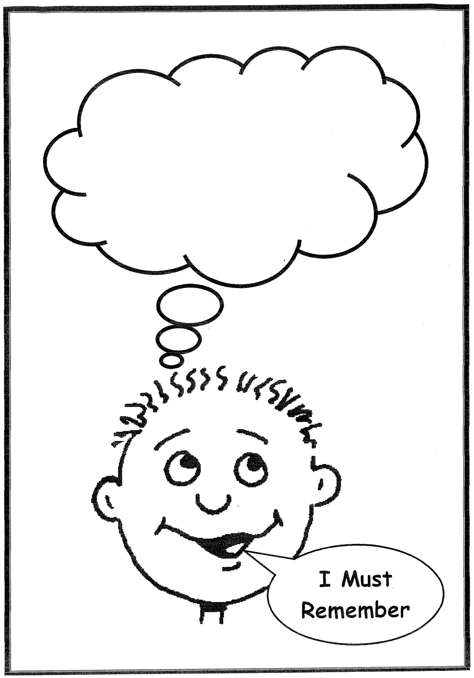

Slide 84
Using a timer
Young people who are active can normally only concentrate for a short period of time before they become bored. Using a timer can be useful for them.. Set the timer to go off after 10 or 15 minutes. This can help to focus on a particular piece of work at home or in school.
The timer can also be used to set break-times in between work. Homework may take a little longer to do but it will help them think more clearly and stay on task.
84

Slide 85
MATERIALS NEEDED FOR SCHOOL SURVIVAL
Make sure you have looked at your checklist and all the things you need for the day have been ticked off and put in your bag.
Time-table to know what lessons you should be in and when assignments are due.
Ask teacher to explain about any homework or assignments you don’t understand.
Note book for you to take down notes or ask teachers to write down any homework information or anything else you don’t understand.
Calculator or small personal computer/ Pens, pencils, paper, books, ruler that you may need.
85

Slide 86
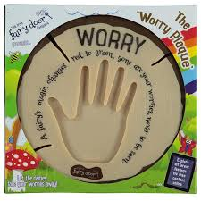


Slide 87



Slide 88



Slide 89
CHILDREN’S/TEEN’S IDEAS……………..
  USING A PUNCHBAG OR ANGRY PILLOW.
  BLOWING UP A BALLOON.
  GOING SOMEWHERE QUIET TO SIT, THINK, and CALM DOWN.
  USING “TURTLE STORY” STRATEGY.
  CRUNCHING UP NEWSPAPER, THROWING IT, RIPPING IT UP.
  BREATHING EXERCISES.
  CLENCHING YOUR FISTS OR TOES TOGETHER.
  DWAWING A PICTURE OF HOW MY ANGER FEELS.
89

Slide 90

Using a YELLOW and RED card system.
Teachers can use this system to help you stop and think before your anger gets out of control.
YELLOW CARD: Stop what you are doing and use the ideas you have discussed to control your anger.
RED CARD: You will receive some sort of punishment for not controlling your anger when given the chance.

Slide 91
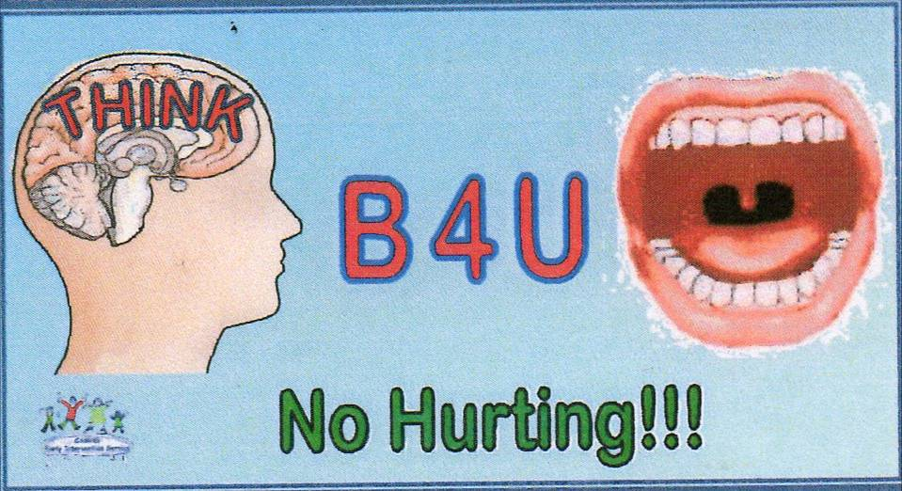

Slide 92
DEALING WITH OPPOSITIONAL BEHAVIOUR
Active children/teens often invite a lot of over control by parents and teachers mainly because of the worry around the safety of self and to others.
This normally happens when the child/teenager is given instructions constantly, thus taking their freedom of choice or control away. They often rebels to gain a sense of control over situations and to reclaim control from a parent or teacher.
At times, it is because they like being in control and want you to argue. Problem is, once you are in one it’s not always that easy to get out.
92

Slide 93
According to diagnostic guidelines:
“ODD is characterized by a repeating pattern of defiant, disobedient, hostile, and negative behaviour toward authority figures”.
To diagnose ODD children must exhibit 4 or more of the following symptoms:
Often loses temper
Often argues with adults.
Actively defies or refuses to comply with rules.
Often blames others for his/her negative behaviour or mistakes.
Often touchy or easily annoyed by others.
Is often angry or resentful.
Can often be spiteful or vindictive.
Test limits.
Refuse to compromise, give in, or negotiate with anyone.

Slide 94
Dealing with Oppositional Defiant Disorder (ODD)
A way around this is to allow the child/teenager some freedom of choice within limits:
Always try to avoid head-on confrontations
Children/teenagers often look for a victim. Avoid face-to-face battles. Give them time for things to calm down. Allow them a “cooling down” break.
Try to calm down impulsive rages
Active children/teenagers can often be impulsive and aggressive, try to slow things down rather than stir things up. Give them space by suggesting alternative options or just walk away for a moment. Let them discuss with you the best way of handling the situation.
94

Slide 95

Avoid arguing
Active children/teenagers argue frequently and often they need to let off steam. Allow them a few minutes of uninterrupted time to have their say.
Be prepared to give and take a little
Don’t back them into a corner, it doesn’t normally work. Discuss and show them other solutions that might work out for them. Let them feel more in control by giving them choices.
Use distractibility to your advantage
Use positive praise about anything you can find good, which can help distract them from the main problem. If the situation is becoming difficult give them a small job to do. Distract them in anyway you can.
95

Slide 96
PRAISE…….IS A VERY EFFECTIVE WAY OF CHANGING YOUR CHILD’S/TEEN’S BEHAVIOUR
Praise needs to be given clearly and often. Different forms of praise include:
VERBAL
NON-VERBAL: such as smiles, high-five, thumbs up, pat on the back etc.
Both can be just as effective.
96

Slide 97
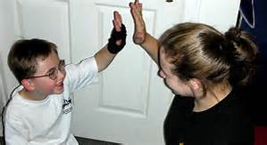

You need to praise:
IMMEDIATELY AFTER SOME APPROPRIATE BEHAVIOUR
This will help the child learn the connection between action and what she/he did. Also increases the chance of the child repeating the behaviour again.
Praise has to be consistent and not something you do only sometimes
97

Slide 98
THE CONCEPT OF SHAPING
You need to praise:
SMALL STEPS THAT ARE ON THE WAY TO THE BEHAVIOUR YOU WANT
EFFORT
HELPFULNESS (NO MATTER HOW SMALL)
WORKING QUIETLY
PUTTING THINGS AWAY TIDY
CO-OPERATING WITH OTHERS/PAYING ATTENTION AND LISTENING
GETTING READY TO GO SOMEWHERE
ANYTHING ELSE THAT YOU FIND GOOD
98

Slide 99
DESCRIPTIVE PRAISE:
For praise to be effective the child must know what behaviour is praised.
E.g.: “You were really good in lessons today.”
The child/teen may not know what you mean by this comment.
More specific praise helps the child understand what was good about the way they behaved.
E.g.: “You were really good today. You sat at your desk quietly and got on with your work. Well Done”.
99

Slide 100
Watch out for the ‘DOUBLE WHAMMY’ praise!
Parents, teachers and professionals can at times give out praise, but then counter-act this by a negative comment immediately after such as:
“I’m really pleased you stayed on task today, but I only wish you would do it more often”.
“Well done, you’ve brought your homework in, but you didn’t do it the last three times I asked you”.
“That’s good, you’ve finished your homework, but when your sister was in my class she always did hers without being told”.
The easiest way of dealing with this is if you know you might say something negative, walk away as soon as you’ve given a positive response.
100

Slide 101
SHARING INFORMATION WITH SCHOOL……….
Personal changes in circumstances that might affect your child such as:
* Parental break-up or severe arguments.
* Family bereavement or pet that has died.
* Family member that has left home.
* Someone close who is seriously ill.
* Any change in your child’s ADHD or other medications.
* If your child has just been diagnosed with ADHD and medicated.
* Changes in normal everyday routines that may affect his/her
behaviour.
* Any new issues with sleep problems or bullying.
* If you feel there are important letters you don’t receive or homework
information .
If you can’t contact a teacher in normal school hours ask can you be kept informed via e-mail or text.

Slide 102






RECOMMENDED BOOKS

Slide 103
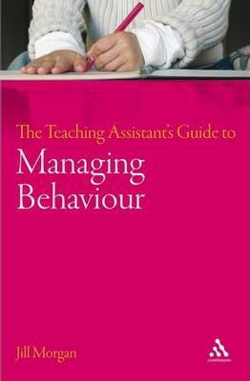




Slide 104
RECOMMENDED BOOKS
NAME OF BOOK | AUTHOR
Understanding ADHD | Dr Christopher Green
Only a Mother Could Love Him | Ben Polis
Helping Children to Build Self-Esteem | Deborah Plummer
All Dogs Have ADHD | Kathy Hoopmann
All Cats Have Asperger Syndrome | Kathy Hoopmann
The Huge Bag of Worries | Virginia Ironside
What Do You Do When You Worry Too Much | Dawn Huebner
My Doctor Says I Have ADHD | Dr Yemula
Toddler Taming (up to age 5) | Dr Christopher Green
Beyond Toddlerdom (5 to 12 years old) | Dr Christopher Green
Dinosaur Divorce Book | Laurene and Mark Brown
The ADHD Effect on Marriage | Mellissa Orlov
Self-Help Skills for People With Autism | Stephen Anderson
Teenagers with ADHD | Chris Zeigler Dendy
Survival Guide for Kids with ADHD | John Taylor
ADHD Workbook for Kids | Lawrence Shapiro

Slide 105
CLASSROOM BOOK TITLES.
The Teaching Assistant’s Guide on ADHD.
The Teaching Assistant’s Guide on ASD.
The Teaching Assistant’s Guide on Dyspraxia.
The Teaching Assistant’s Guide on Behaviour in the Classroom.
Managing ADHD in School.
ADHD In The Schools.
Teach and Manage Children with ADHD.
Source: Book Depository. bookdepository.com

